Slide 1
Breakeven and Payback Analysis

Slide 2
LEARNING OUTCOMES
Breakeven point – one parameter
Breakeven point – two alternatives
Payback period analysis

Slide 3
Breakeven Point
Value of a parameter that makes two elements equal
The parameter (or variable) can be an amount of revenue, cost, supply, demand, etc. for one project or between two alternatives
One project - Breakeven point is identified as Q_{BE}. Determined using linear or non-linear math relations for revenue and cost
Between two alternatives - Determine one of the parameters P, A, F, i, or n with others constant
Solution is by one of two methods:
Direct solution of relations
Trial and error

Slide 4
Cost-Revenue Model ― One Project
Quantity, Q — An amount of the variable in question, e.g., units/year, hours/month
Breakeven value is Q_{BE}
Fixed cost, FC — Costs not directly dependent on the variable, e.g., buildings, fixed overhead, insurance, minimum workforce cost
Variable cost, VC — Costs that change with parameters such as production level and workforce size. These are labor, material and marketing costs. Variable cost per unit is v
Total cost, TC — Sum of fixed and variable costs, TC = FC + VC
Revenue, R — Amount is dependent on quantity sold
Revenue per unit is r
Profit, P — Amount of revenue remaining after costs
P = R – TC = R – (FC+VC)

Slide 5
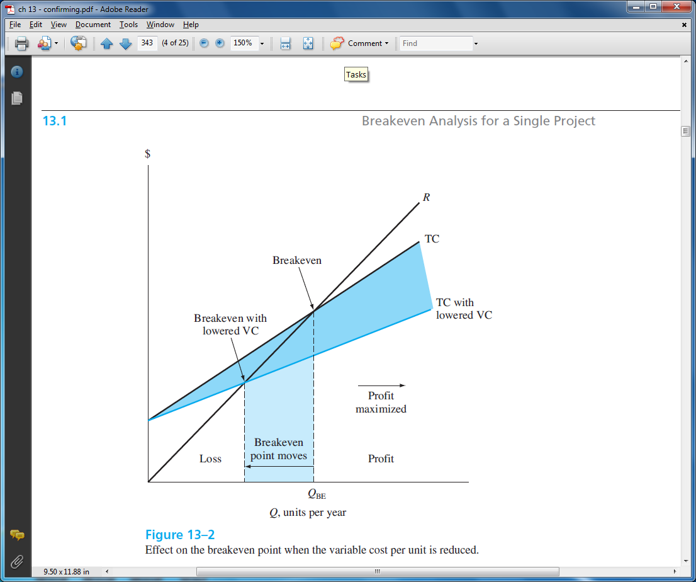
Breakeven for linear R and TC
Set R = TC and solve for Q = Q_{BE}
R = TC
rQ = FC + vQ
FC
r – v
When variable cost, v, is lowered, Q_{BE} decreases (moves to left)
Q_{BE} =

Slide 6
Example: One Project Breakeven Point
A plant produces 15,000 units/month. Find breakeven level if FC = $75,000 /month, revenue is $8/unit and variable cost is $2.50/unit. Determine expected monthly profit or loss.
Solution: Find Q_{BE} and compare to 15,000; calculate Profit
Q_{BE} = 75,000 / (8.00-2.50) = 13,636 units/month
Production level is above breakeven Profit
Profit = R – (FC + VC)
= rQ – (FC + vQ) = (r-v)Q – FC
= (8.00 – 2.50)(15,000) – 75,000
= $ 7500/month

Slide 7
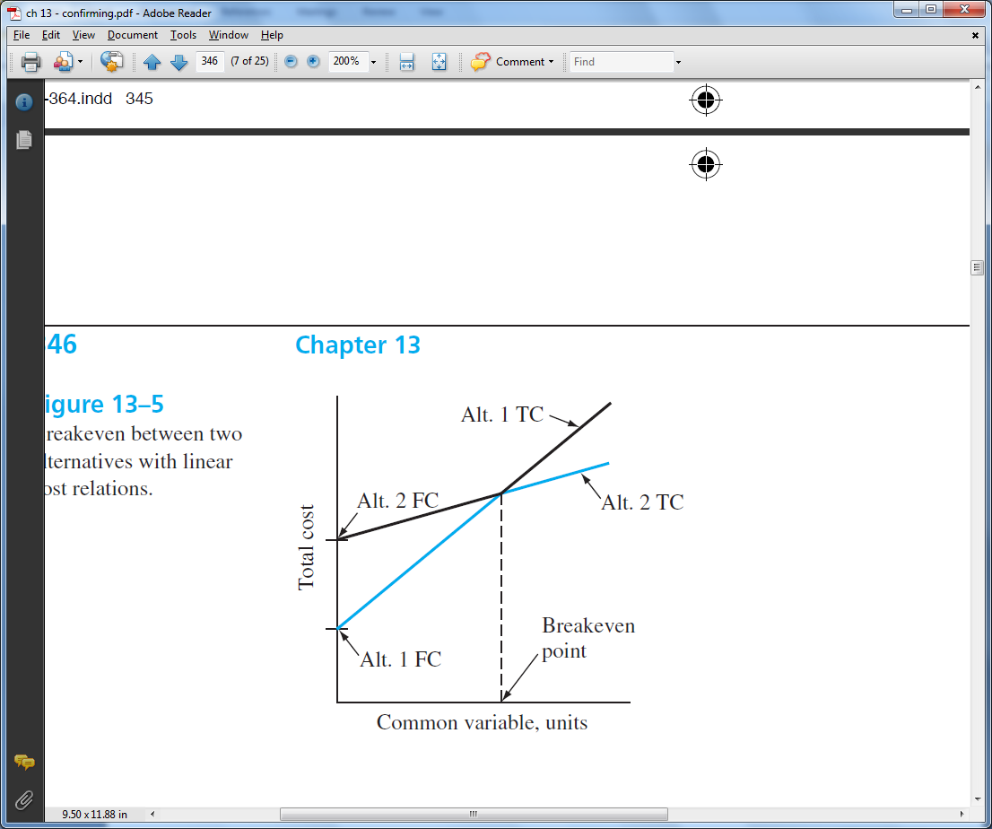
Breakeven Between Two Alternatives
To determine value of common variable between 2 alternatives, do the following:
Define the common variable
Develop equivalence PW, AW or FW relations as function of common variable for each alternative
Equate the relations; solve for variable. This is breakeven value
Selection of alternative is based on anticipated value of common variable:
Value BELOW breakeven;
select higher variable cost
Value ABOVE breakeven;
select lower variable cost

Slide 8
Example: Two Alternative Breakeven Analysis
Perform a make/buy analysis where the common variable is X, the number of units produced each year. AW relations are:
AW_{make} = -18,000(A/P,15%,6) +2,000(A/F,15%,6) – 0.4X
AW_{buy} = -1.5X
Solution: Equate AW relations, solve for X
-1.5X = -4528 - 0.4X
X = 4116 per year
Breakeven value of X
AW, 1000 $/year
8
7
6
5
4
3
2
1
0
AW_{buy}
AW_{make}
If anticipated production > 4116,
select make alternative (lower variable cost)
1 2 3 4 5
X, 1000 units per year

Slide 9
Payback Period Analysis
Payback period: Estimated amount of time (n_{p}) for cash inflows to recover an
initial investment (P) plus a stated return of return (i%)
Types of payback analysis: No-return and discounted payback
No-return payback means rate of return is ZERO (i = 0%)
Discounted payback considers time value of money (i > 0%)
Caution: Payback period analysis is a good initial screening tool, rather than the primary method to justify a project or select an alternative (Discussed later)

Slide 10
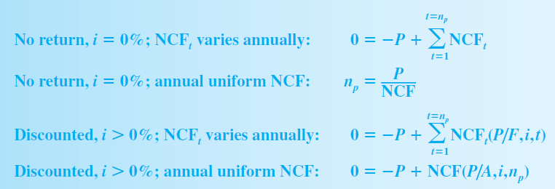
Payback Period Computation
Formula to determine payback period (n_{p})
varies with type of analysis.
NCF = Net Cash Flow per period t
Eqn. 1
Eqn. 2
Eqn. 3
Eqn. 4

Slide 11
Points to Remember About Payback Analysis
No-return payback neglects time value of money, so no return is expected for the investment made
No cash flows after the payback period are considered in the analysis. Return may be higher if these cash flows are expected to be positive.
Approach of payback analysis is different from PW, AW, ROR and B/C analysis. A different alternative may be selected using payback.
Rely on payback as a supplemental tool; use PW or AW at the MARR for a reliable decision
Discounted payback (i > 0%) gives a good sense of the risk involved

Slide 12
Example: Payback Analysis
System 1 System 2
First cost, $ 12,000 8,000
NCF, $ per year 3,000 1,000 (year 1-5)
3,000 (year 6-14)
Maximum life, years 7 14
Problem: Use (a) no-return payback, (b) discounted payback at
15%, and (c) PW analysis at 15% to select a system. Comment
on the results.
Solution: (a) Use Eqns. 1 and 2
n_{p1} = 12,000 / 3,000 = 4 years
n_{p2} = -8,000 + 5(1,000) + 1(3,000) = 6 years
Select system 1

Slide 13
Example: Payback Analysis (continued)
System 1 System 2
First cost, $ 12,000 8,000
NCF, $ per year 3,000 1,000 (year 1-5)
3,000 (year 6-14)
Maximum life, years 7 14
Solution: (b) Use Eqns. 3 and 4
System 1: 0 = -12,000 + 3,000(P/A,15%,n_{p1})
n_{p1} = 6.6 years
System 2: 0 = -8,000 + 1,000(P/A,15%,5)
+ 3,000(P/A,15%,n_{p2} - 5)(P/F,15%,5)
n_{p2} = 9.5 years
Select system 1
(c) Find PW over LCM of 14 years
PW₁ = $663
PW₂ = $2470
Select system 2
Comment: PW method considers cash flows after payback period. Selection changes from system 1 to 2

Slide 14
Summary of Important Points
Breakeven amount is a point of indifference to
accept or reject a project
One project breakeven: accept if quantity is > Q_{BE}
Two alternative breakeven: if level > breakeven,
select lower variable cost alternative (smaller slope)
Payback estimates time to recover investment.
Return can be i = 0% or i > 0%
Use payback as supplemental to PW or other analyses,
because n_{p} neglects cash flows after payback,
and if i = 0%, it neglects time value of money
Payback is useful to sense the economic risk in a project

